Slide 1

DriverPass System Analysis
Zelle
Notes:
[No speaker notes required for this slide.]

Slide 2

System Requirements
Two Functional Requirements
Enable customers to select one of three driving package options
The system will allow students to book their driving lessons on the portal
Two Nonfunctional Requirements
Adaptability
System Performance
Notes:
Functional requirements provide insight into how the system should perform specific operations and nonfunctional requirements depict the work-flow or characteristics of the system.
The first of two functional requirements listed is the ability to allow customers to select one of three driving packages. Within the DriverPass portal, after a customer logs in, they will have the option to select one of the three different packages our client provides. Following the selection via hyperlink, the customer is brought to a new page that will request payment information. Payment will be made for the cost listed for the package they chose, then the customer will be able to start scheduling their driving lessons.
The second functional requirement states the system will allow students to book their driving lessons on the portal. After a customer logs into their account with their unique login information, they will have the option to view the calendar and select a date and time to reserve a driving lesson. Lessons that have already been booked will have been blocked from the calendar, so reservations are not double booked.
Next, we need to consider nonfunctional requirements of our system. Our first nonfunctional requirement is adaptability. From the administrative and IT standpoint, you want to be sure that every bit of data is stored on the “backend” which means that data can not be accessed by anyone, but the people provided unique access. In this case, only IT administrative staff will be able to access this data. The IT admin will be able to access all components that are responsible for maintaining this system, which will include the server it runs on and the database where all sensitive information is stored.
Our second nonfunctional requirement is system performance. From our understanding, you the client, requested the use of a web-based cloud environment. This will be cost effective for your company and allow the system to be scaled up or down in size depending on your needs as your company grows and changes. The system will be expected to have minimal lag time, meaning no long waits in between clicking links. Updates to the system on either a bi-weekly or monthly basis to make sure the system is functioning properly and fits your businesses’ needs.

Slide 3
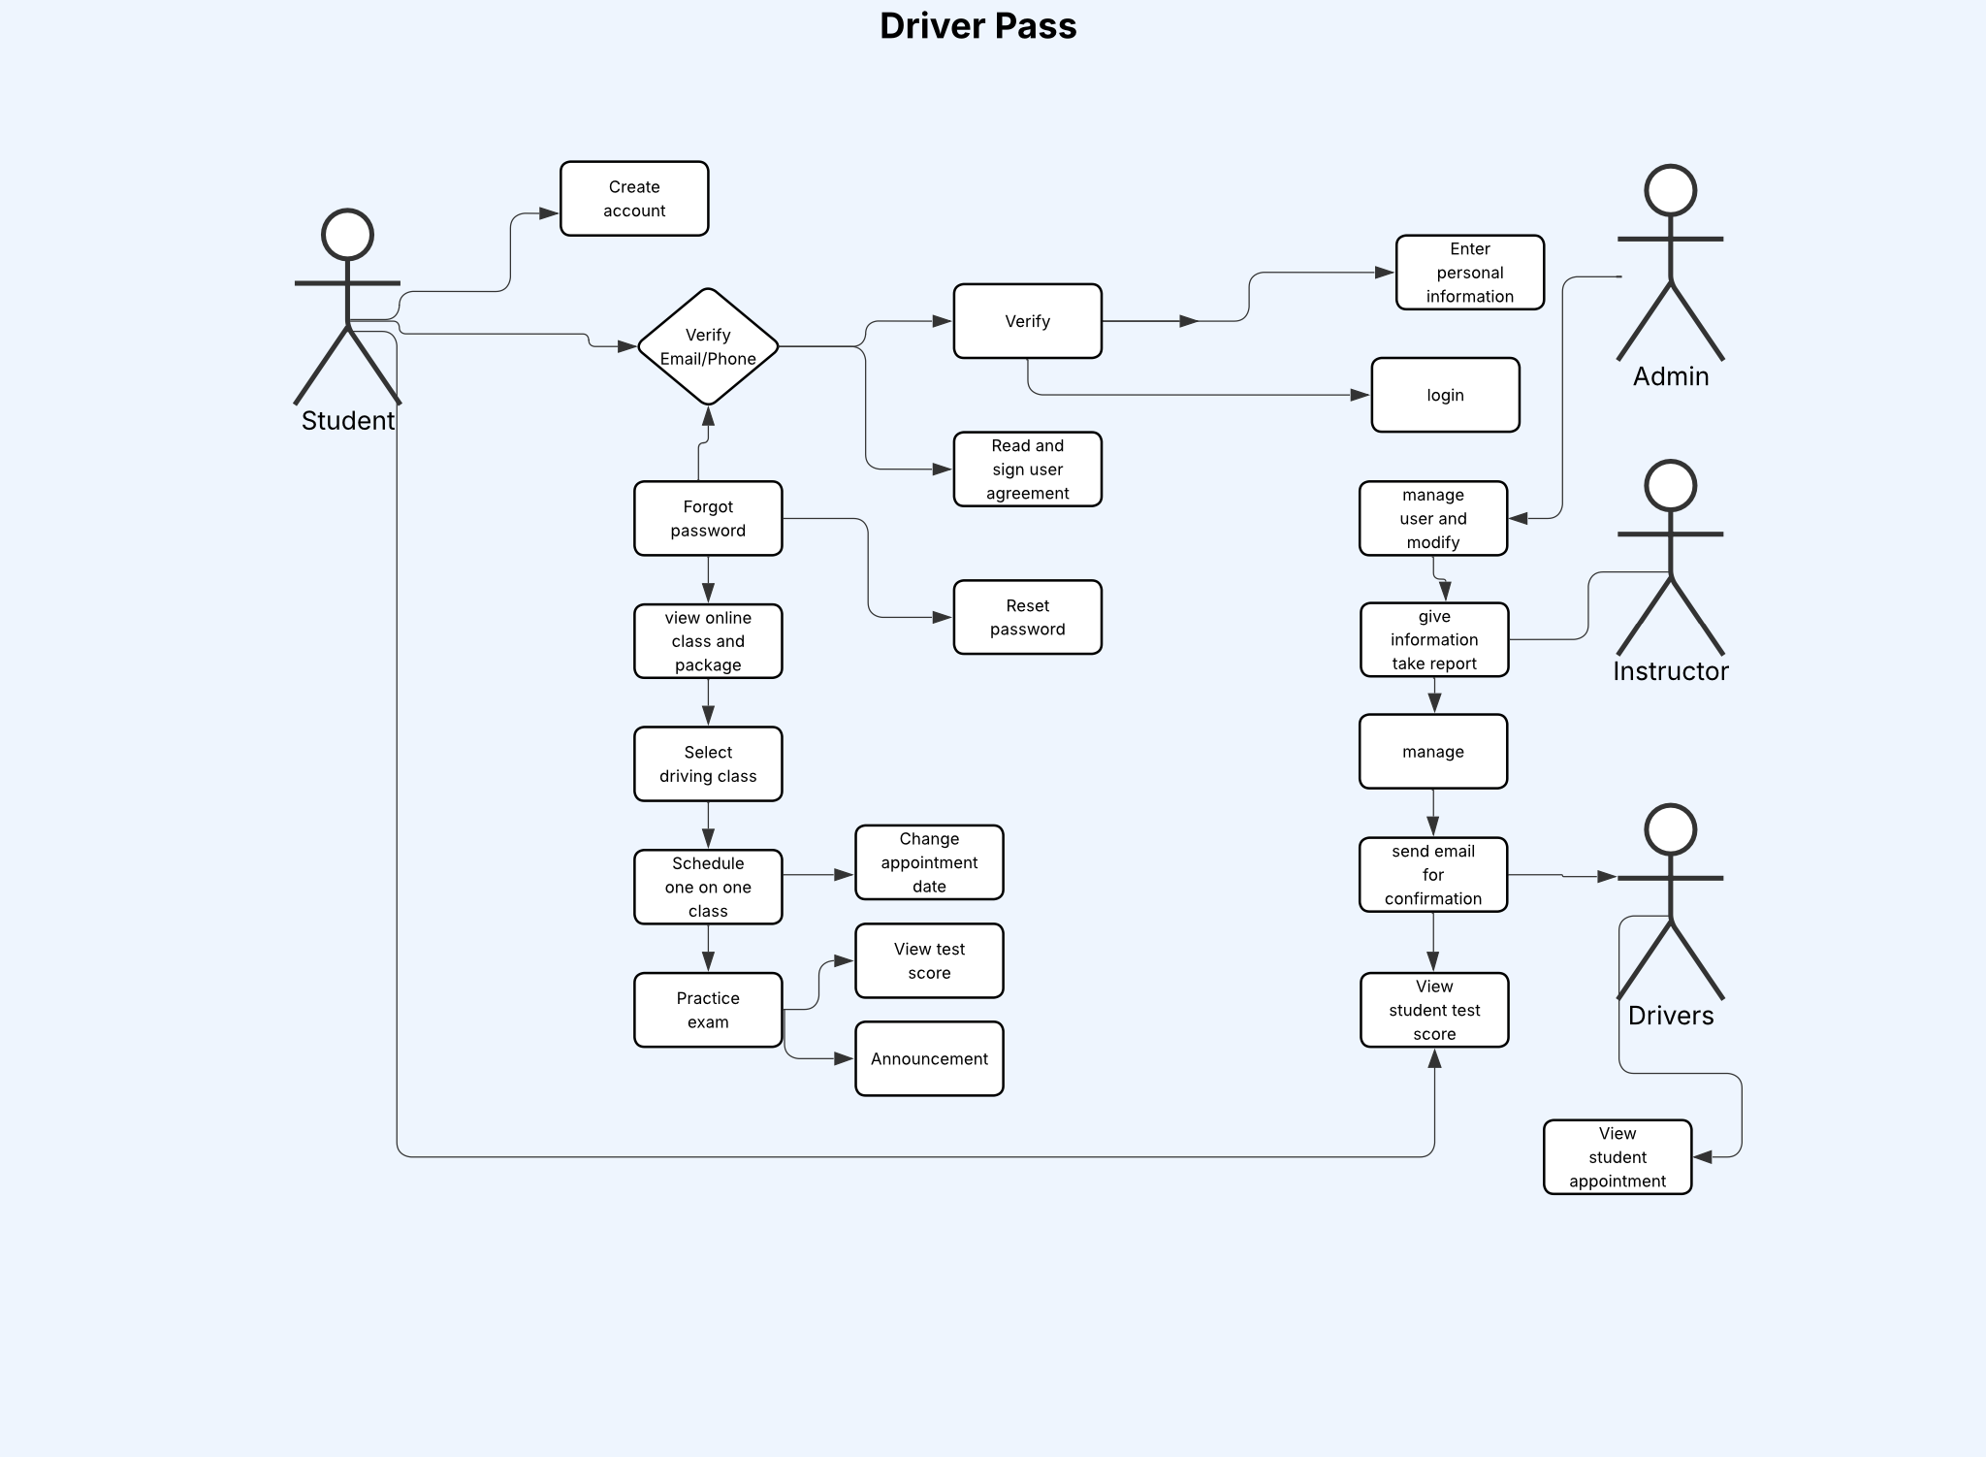
Use Case Diagram
[Insert your use case diagram here.]
Notes:
The different “actors” or people engaging with this system will include the customers, you the administrative team, and the secretaries. Customers will be able to create an account, book appointments and make changes to them, view lesson notes from instructors, login to contact customer support, and reset passwords. Administrators will be able to run reports, receive DMV policy updates, and reset passwords for customers. The secretaries will be able to manage appointment bookings. We kept all of your needs in mind while creating this diagram so you can truly understand how it should function. It allows you to get a good idea of what operations each person using this system will be able to perform. Of course, with each person having their own login they will be limited to accessing only the information they have been approved for having access to. For example, secretaries will only ever be able to manage appointments. They will not be allowed to view customer credit card information, and customers will only be able to view the information provided to them within their account following submitting their unique login information.

Slide 4
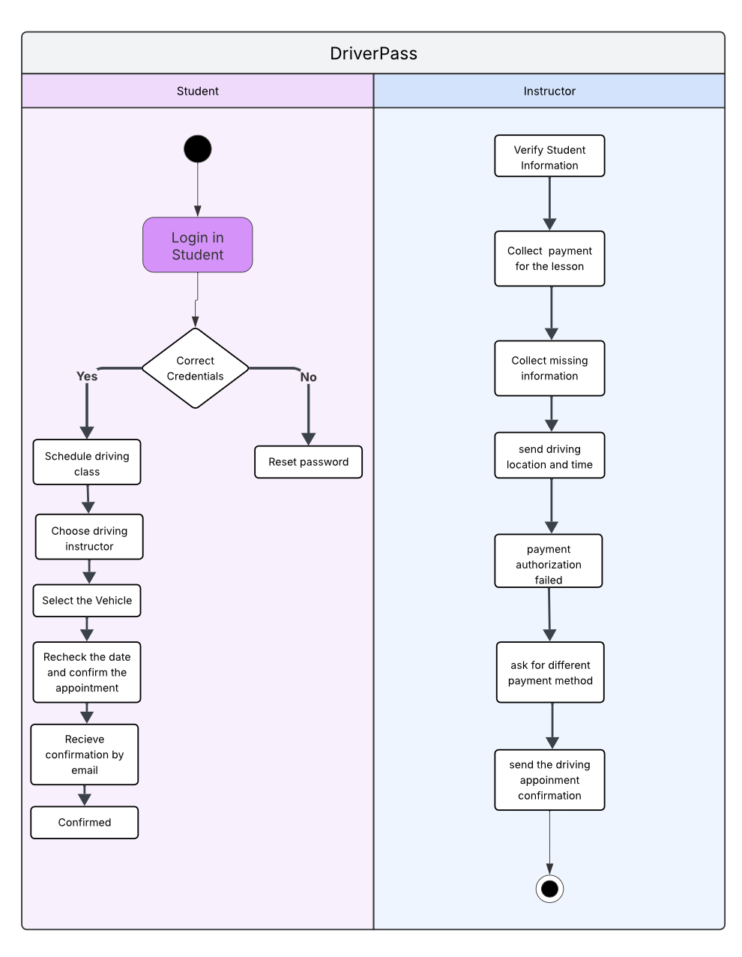
Activity Diagram
Notes:
Here you will see the how the system will function when a customer calls your administrative team to register their account and sign up for driving lessons. The customer will contact the secretary who will search by their name to see if they already have registered. If they have then they will not need to reregister. If not, they will intake the customer’s full name, address, confirm pick-up and drop-off locations, and intake credit card information. If the secretary tries to verify the credit card information in the system and it fails, then registration cannot occur. If the credit card information is verified, then the confirmation of this registration will be sent to the customer. The customer will then be prompted to schedule lessons via the web-portal with a secure login.

Slide 5
Security
Important Password Features:
🔒 Case-Sensitive Passwords: Users must create secure passwords that are case-sensitive for enhanced protection.
✅ Multi-Factor Authentication (MFA): A second verification step (such as a code sent to a trusted device) ensures only authorized access.
🚫 Limited Login Attempts: Maximum of 3 login attempts allowed to prevent brute-force attacks.
Notes:
One of the best ways to implement security measures is by setting parameters for the logins being created by all the people using the system. Everyone, both customers and administrators, will need to have a unique login to view their DriverPass account. The input of a personal email for the username and then a personalized password that is case-sensitive will be required. To ensure the sensitive data, such as street address and credit card information for customers or the access to reports and reservation information for your administrative team is secure, the implementation of security features, such as multi-factor authentication will be utilized. Multi-factor authentication, simply put, is a way to verify the person logging into their account is really who they say they are. To ensure this, sending a secure passcode generated by the system will be sent to the customers device via text or email. If a person forgets their password, they will be prompted to change it via a link on the login window where IT administrators can initiate the change on their behalf or utilize the self-service link. It is also important to make sure there is a limit to how many times a person can attempt to login to their account. A maximum of three attempts will be allowed to attempt to login and then they will be locked out. In order to unlock it, the IT administrator will be able to unlock it on their end, ensuring there has not been a hacking attempt.

Slide 6
System Limitations
Time
Budget
Technology
Resources
Notes:
Our first limitation is time. We only have between January 22nd and May 10th to complete this system, so it is imperative we use our time wisely and adequately plan the appropriate steps necessary to complete each of our tasks. Budget will depend on your, our client, and what you are able to afford. This bleeds into my next two limitations, technology and resources. Your budget will dictate both. Technology limitations include what hardware you can afford for your offices and administrative team. Technology limitations can also include what resources our customers have access to, such as older mobile devices that may not support the browsers our system will be implemented on. Resource limitations is directly impacted by your budget and the resources I speak of include anything from the number of skilled technical members that can be assigned to building your system and how efficiently you want it to be completed and to run.

